Slide 2
Computer Applications in Business and Society
A demand for computer professionals continues to grow.
IT is predicted to be the fastest growing industry for the next several years

Slide 3
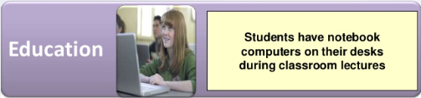
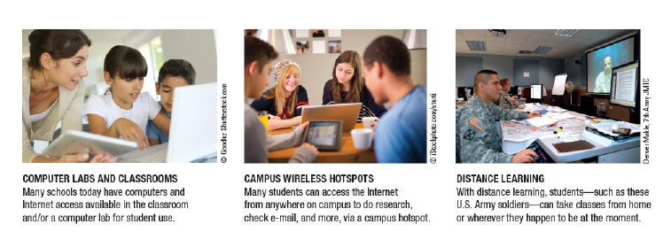
Computer Applications in Business and Society

Slide 4
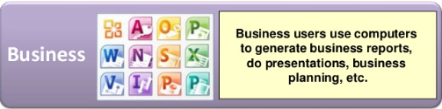
Computer Applications in Business and Society

Slide 5
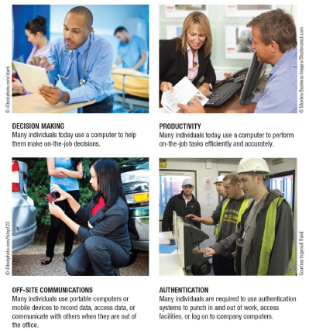
Computer Applications in Business and Society
On the job
Computers are used authentication, for decision making, authentication, communication any time any where, for decision making to perform effectively and accurately

Slide 6
Professional Ethics
Professional ethics are a category of ethics, and here we discus the professional ethics relevant to computing
Awareness of professional ethics is gaining importance with time as the decision-making process in the work place keeps on increasing in complexity
The professional ethics provide a way of simplifying that decision making process

Slide 7
Professional Ethics
Ethics - Refers to the rules and standards governing the conduct of an individual with others.
Business Ethics - Is code of morals of a particular profession. Is the standards of conduct of a given profession
Information Ethics - Is defined as agreement among information systems professionals to do right and to avoid wrong in their work

Slide 8
Professional Ethics
Privacy
Refers to the right of people not to reveal information about them.
Is the right to keep personal information, such as personal e-mail messages, medical histories, student records, and financial information from getting into the wrong hands

Slide 9
Professional Ethics
Privacy at Work
Some experts believe that there will be a collision between workers who want their privacy and companies that demand to know more about their employees.
Computer-monitoring systems tie directly into computerized workstations; specialized computer programs can track every keystroke made by user

Slide 10
Professional Ethics
Email Privacy Issues
Federal law allows employers to monitor e-mail sent and received by employees.
Email messages that have been erased from hard disks may be retrieved and used in lawsuits because the laws of discovery demand that companies produce all relevant business documents. The use of email among public officials may violate “open meeting” laws

Slide 11
Professional Ethics
Ethical Approach to Information Accuracy
Individuals should be given an opportunity to correct inaccurate information held about them in database
Contents of databases containing data about individuals should be reviewed at frequent intervals, with obsolete data discarded
System safeguards, such as control audits are necessary to maintain information accuracy
A professional should not misrepresent his or her qualifications to perform a task
A professional should indicate to his or her employer the consequences to be expected if his or her judgment is overruled

Slide 12
Professional Ethics
Accessibility
Access to files, both for online and offline, should be restricted only to those who have a legitimate right to access
Many organizations keep a transaction log that notes all accesses or attempted accesses to data
Most LAN management software includes this function

Slide 13
Professional Ethics
Property
Many networks have audit controls to track which files opened, which programs and servers were used, and so on
This creates an audit trail, a record of how a transaction was handled from input through processing and output

Slide 14
Professional Ethics
Ten Commandments of Computer Ethics
Thou shalt not use a computer to harm other people.
Thou shalt not interfere with other people’s computer work.
Thou shalt not snoop around in other people’s files.
Thou shalt not use a computer to steal.
Thou shalt not use a computer to bear false witness.
Thou shalt not use or copy software for which you have not paid.

Slide 15
Professional Ethics
Ten Commandments of Computer Ethics
Thou shalt not use other people’s computer resources without authorization.
Thou shalt not appropriate other people’s intellectual output.
Thou shalt think about the social consequences of the program you write.
Thou shalt use a computer in ways that show consideration and respect.

Slide 16
REFERENCES
Website:
Fungsi Motherboard Processor Memori Dan Harddisk | Computer hardware, Computer hardware store, Computer Pinterest. https://www.pinterest.ph/pin/88594317657692933/?mt=login
Unit 4 - Hardware & Ergo - Davids BTA30 Portfolio 2016 Sites.google.com. https://sites.google.com/site/davidsbtaportfolio/unit-4---hardware-ergo.
Computer Software Icon #229946 - Free Icons Library. Icon-library.com. https://icon-library.com/icon/computer-software-icon-14.html
https://edu.gcfglobal.org/en/word2016/understanding-onedrive/1/
https://www.rapidtables.com/code/text/ascii-table.html
https://www.vskills.in/certification/tutorial/ms-word-interface-and-editing-document/
https://itsourcecode.com/ms-word/ms-word-window-explore-its-features/

Slide 17
--- END ---

